Slide 1


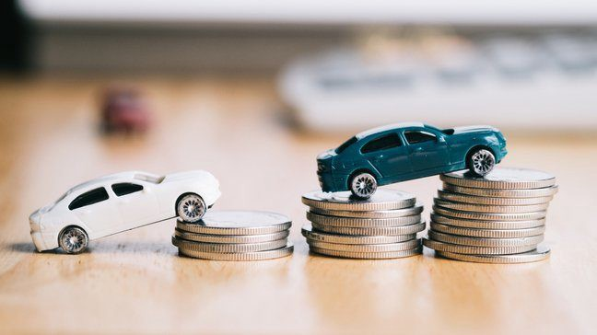
CAR PRICE PREDICTION

Slide 2
AGENDA
Introduction​
Problem Statement
Business Goal
Technical Requirement
Exploratory Data Analysis (EDA)
Data Pre-Processing
Visualization
Built Model
Saved Best Model
Summary​

Slide 3
Introduction
With the covid 19 impact in the market, we have seen lot of changes in the car market. Now some cars are in demand hence making them costly and some are not in demand hence cheaper. One of our clients works with small traders, who sell used cars. With the change in market due to covid 19 impact, our client is facing problems with their previous car price valuation machine learning models. So, they are looking for new machine learning models from new data. We have to make car price valuation model. This project contains two phase:
Data Collection Phase : We have to scrape at least 5000 used cars data. We can scrape more data as well, it’s up to us. More the data better the model. In this section we need to scrape the data of used cars from websites (Olx, cardekho, Cars24 etc.) We need web scraping for this. We have to fetch data for different locations. The number of columns for data doesn’t have limit, it’s up to us and our creativity. Generally, these columns are Brand, model, variant, manufacturing year, driven kilometers, fuel, number of owners, location and at last target variable Price of the car. This data is to give us a hint about important variables in used car model. We can make changes to it, we can add or you can remove some columns, it completely depends on the website from which we are fetching the data. Try to include all types of cars in our data for example- SUV, Sedans, Coupe, minivan, Hatchback.
Model Building Phase : After collecting the data, you need to build a machine learning model. Before model building do all data pre-processing steps. Try different models with different hyper parameters and select the best model. Follow the complete life cycle of data science

Slide 4
Business Goal:
One of our clients works with small traders, who sell used cars. With the change in market due to covid 19 impact, our client is facing problems with their previous car price valuation machine learning models. So, they are looking for new machine learning models from new data. We have to make car price valuation model. This project contains two phases:
Data Collection Phase
Model Building Phase

Slide 5
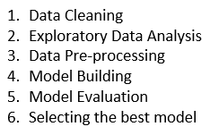
Technical Requirements:
We have to made car price valuation model. This project contains two phases:
Data Collection Phase: We have scraped more than 5000 used cars data from websites: cardekho, Olx and cars24. We have fetched data for different locations. All types of cars are present in data for example- SUV, Sedans, Coupe, minivan, Hatchback. After scraping converted into csv file.
Model Building Phase: After collecting the data, built a machine learning model. Before model building have done all data pre-processing steps. Tried different models with different hyper parameters and selected the best model. Followed the complete life cycle of data science. Include all the steps like:

Slide 6
Exploratory Data Analysis (EDA)
Checked Total Numbers of Rows and Column
Checked All Column Name
Checked Data Type of All Data
Checked for Null Values
Checked for special character present in dataset or not
Checked total number of unique value
Dropped irrelevant Features
Replaced duplicate values, special characters and irrelevant data
Checked Information about Data
Checked all features through visualization.

Slide 7
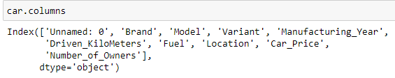
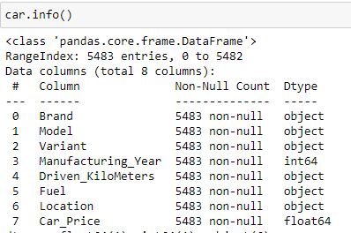
Data Description
The dataset contains 5616 records (rows) and 10 features (columns). And after removal of irrelevant data and column, we remains with 5483 records (rows) and 8 features (columns).

Slide 8
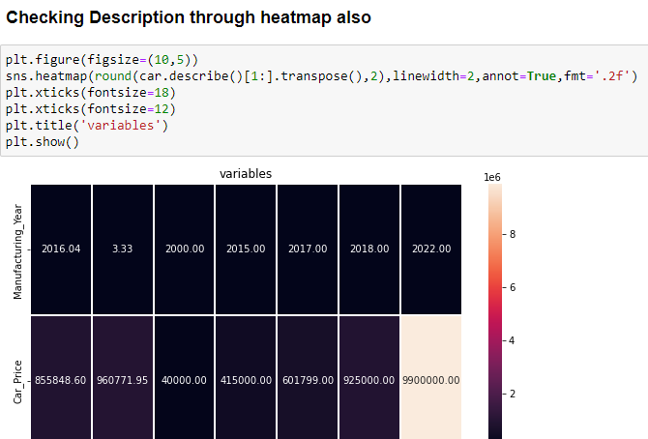
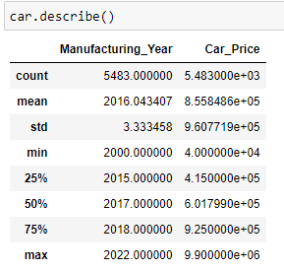
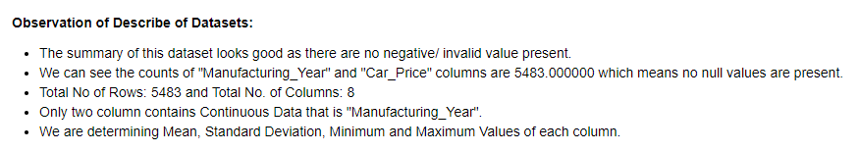
DataSet Description

Slide 9
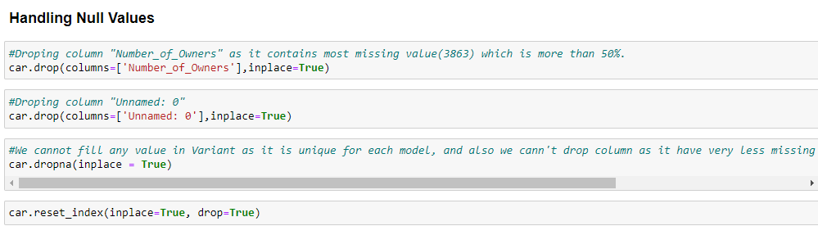
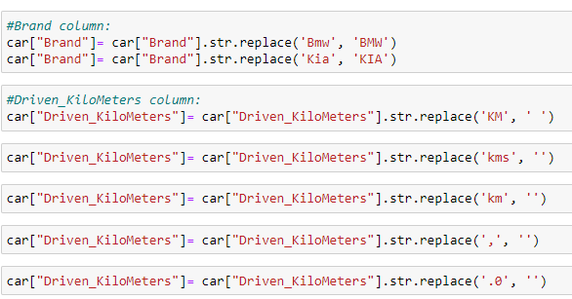
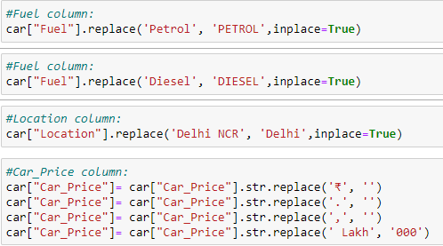
Data Cleaning

Slide 10
Data Visualization
Univariate Analysis Using Countplot 2. Bivariate Analysis (for comparison between features and target) Using Catplot and Scatterplot 3. Multivariate Analysis Using Pairplot (comparison between all continuous features and target)

Slide 11
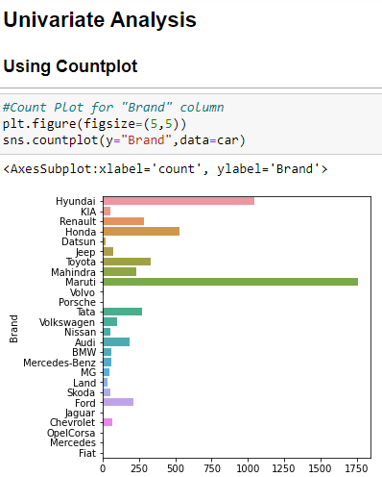

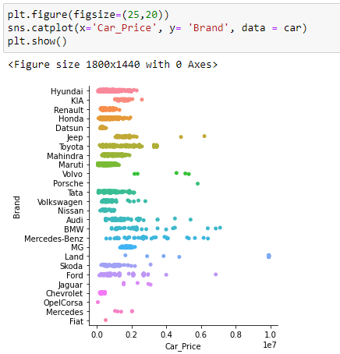

Slide 12
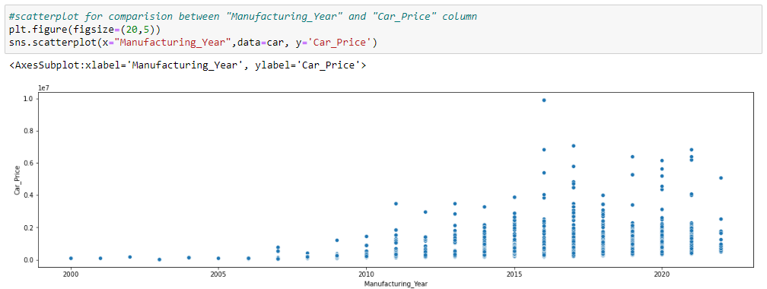
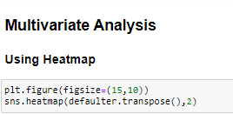
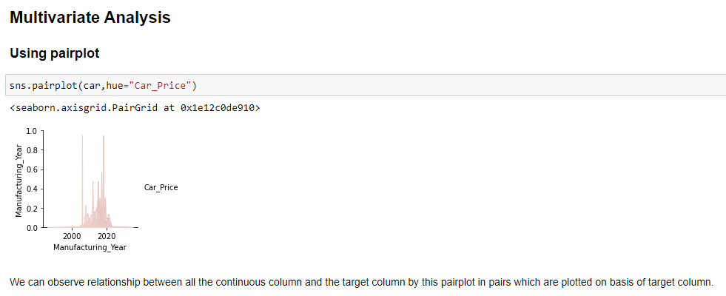

Slide 13
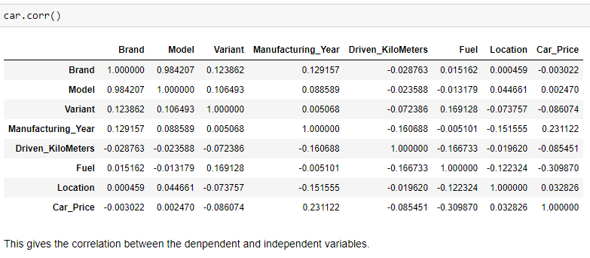
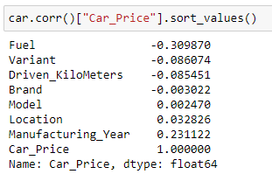
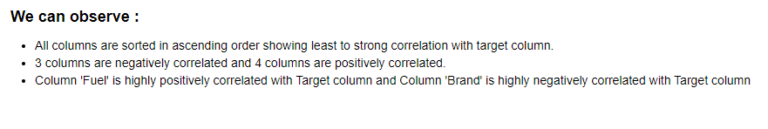
Checking Correlation

Slide 14
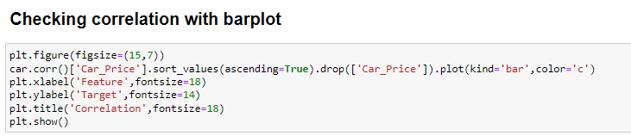
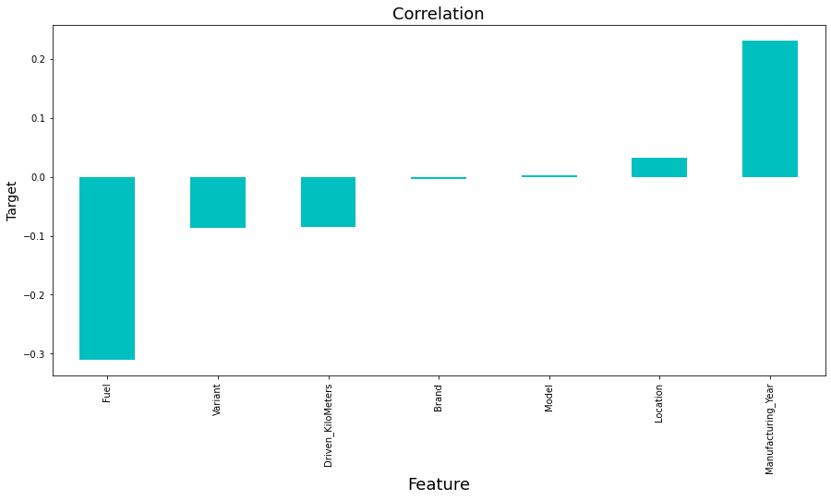
Correlation is checked for relation between the dependent and independent variables. Also Checked through heatmap and BarPlot (Visualization) Checking Correlation through Barplot :

Slide 15

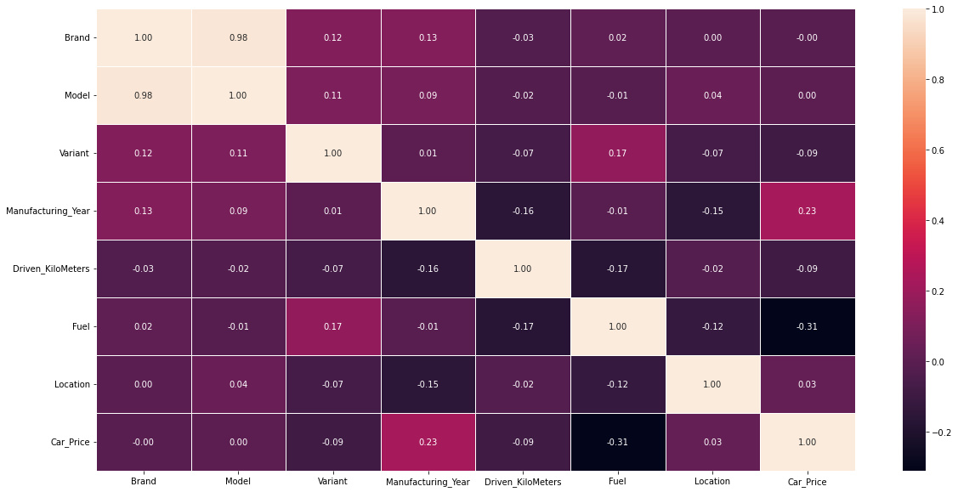

Slide 16
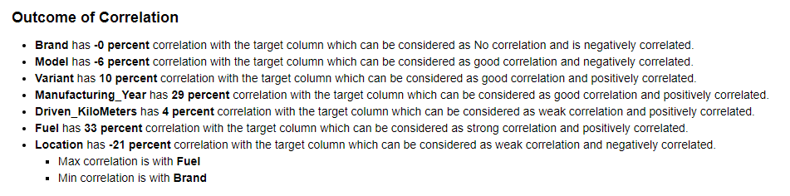

Slide 17
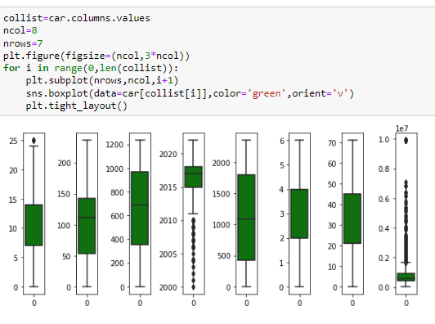
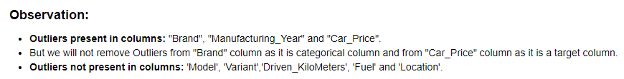
Checking Outliers

Slide 18
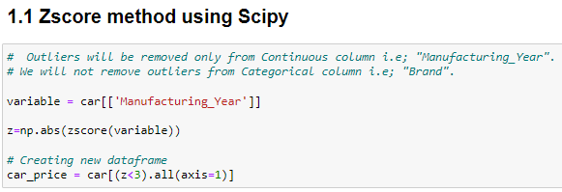
Removing Outliers
Outliers are removed only from continuous features and not from target
Checking two methods and compare between them which is give less percentage loss and then using that method for further process. Zscore method using Scipy IQR (Inter Quantile Range) method

Slide 19
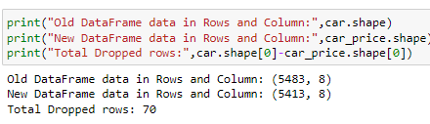
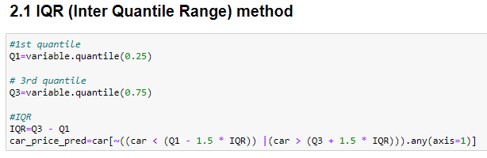
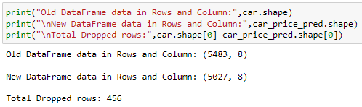
Comparing shape of old and new DataFrame after outliers removal
Comparing shape of old and new DataFrame after outliers removal

Slide 20
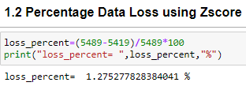
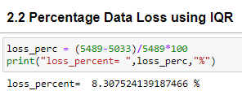
Comparing Data Loss Using both Method after Outlier Removal

Slide 21
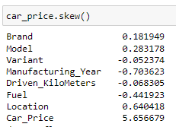
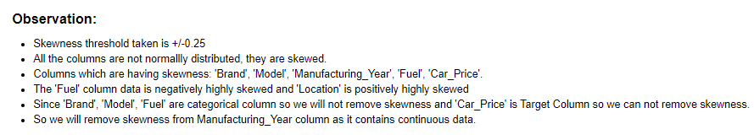
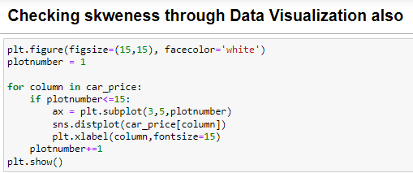
Checking Skewness

Slide 22
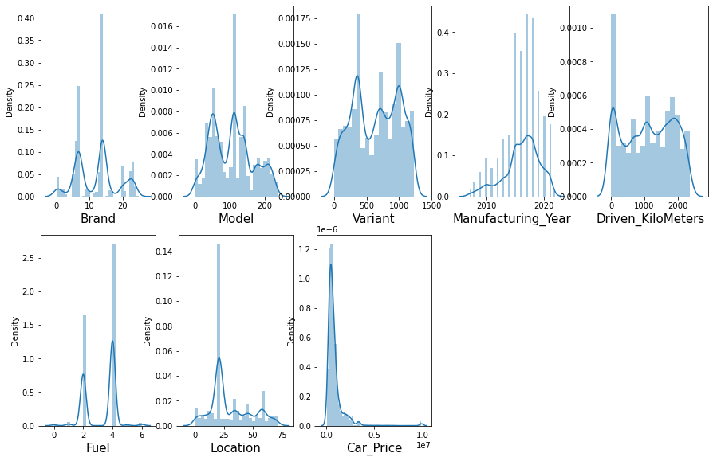

Slide 23
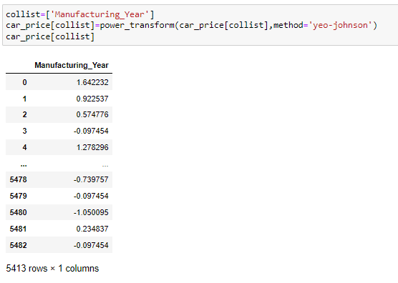
Removing skewness
Using yeo-johnson method

Slide 24
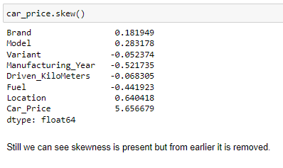
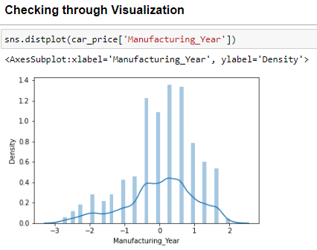
checking skewness after removal

Slide 25


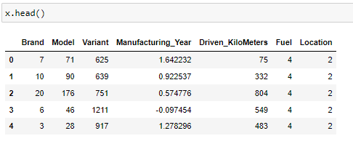
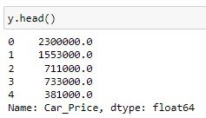


Slide 26
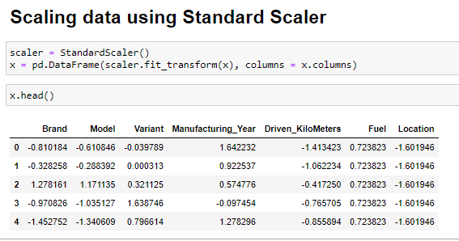

Slide 27
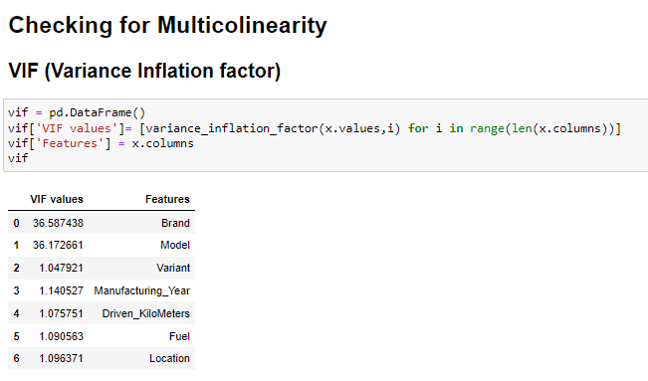

Slide 28
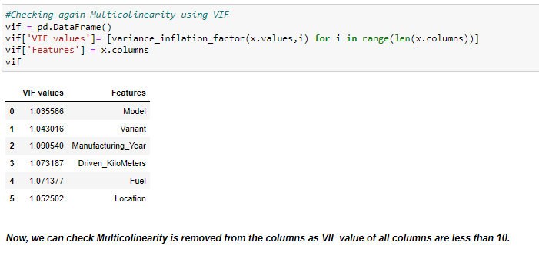

Slide 29

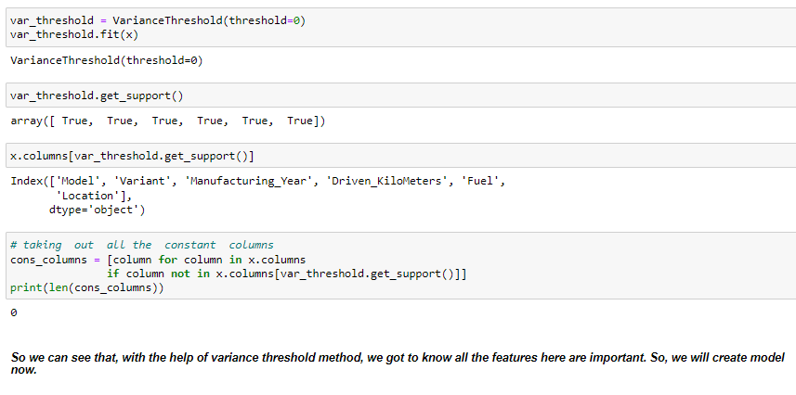

Slide 30
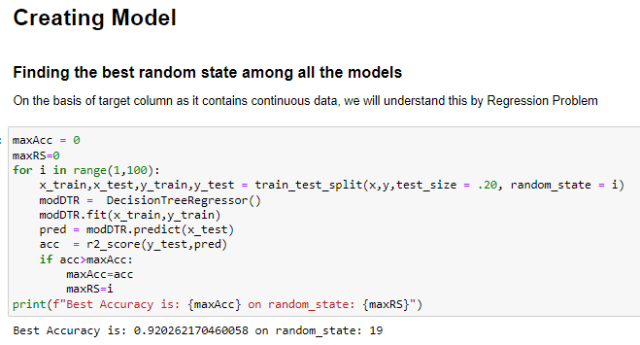
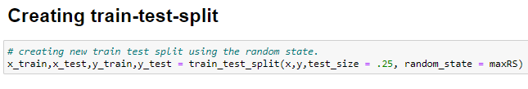

Slide 31
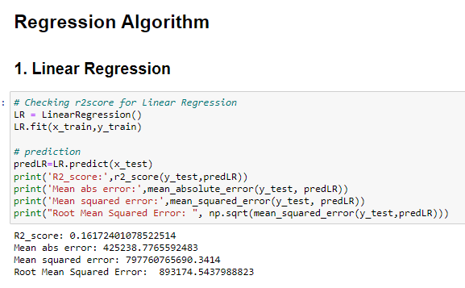

Slide 32
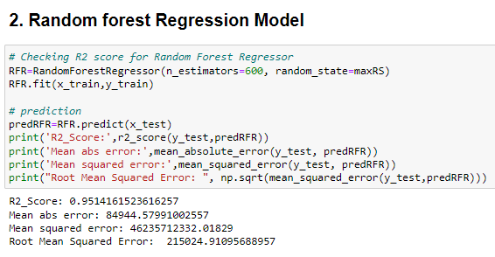

Slide 33
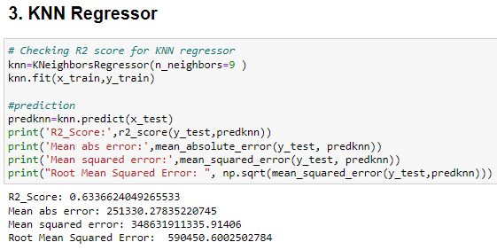

Slide 34
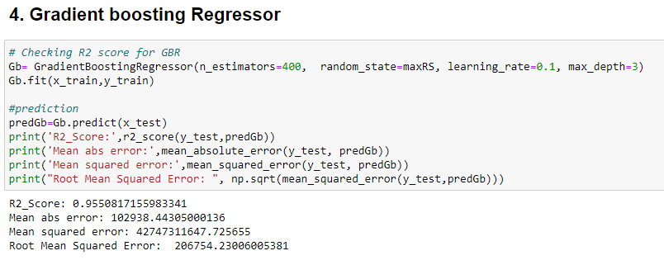

Slide 35
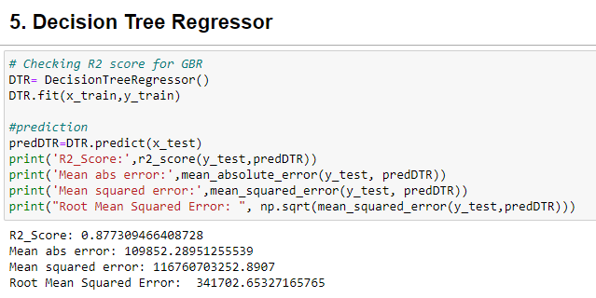

Slide 36


Slide 37



Slide 38



Slide 39


Slide 40


Final Procedure: 1. Saving the model 2. Comparing Actual and Prediction

Slide 41



Slide 42



3. Saving the model in CSV format

Slide 43
SUMMARY
Here we have made a new car price valuation model as due to covid 19 impact previous car price valuation machine learning models is not working well because some cars are in demand hence making them costly and some are not in demand hence cheaper.
For new car price valuation model, we have done prediction on basis of Data using EDA, Data Cleaning, Data Visualization, Data Pre-processing, Checked Correlation, removed irrelevant features , Removed Outliers, Removed Skewness and at last train our data by splitting our data through train-test split process.
Built our model using 5 models and finally selected best model which was giving best accuracy that is Gradient Boosting Regressor. Then tunned our model through Hyper Tunning using GridSearchCV. And at last compared our predicted and Actual Price of Car. Thus our project is completed.

Slide 44
THANK YOU
Presented by: Suneel Kumar
SME Name: Mr. Shwetank Mishra

